Slide 1
Learning Summary - 2021 Q3
Gufran Khan
JAVA, 2 Years of Experience

Slide 2

My Learning path
List of courses I completed
Course Name | Platform | Key Concepts
Reactive RESTFUL APIs using Spring Boot/WebFlux | Udemy | Reactive Programming Basics,Reactive Rest API
Docker | Youtube | Docker Image,Containerization
AWS Basics | Youtube | Aws fundamentals ,EC2 , Lightsail

Slide 3
My learning summary
Spring Reactive
Reactive Programmimg
Non Blocking Rest API
BackPressure
Streaming
Hands on exercise
Book Store Crud operation using Non Blocking Rest API using Annotated Controller with MongoDb POC

Slide 4
Traditional Approach

Slide 6
Traditional Programming

Slide 7
Back Pressure (Reactive Programming)

Slide 8
My learning summary
Docker
Introduction of Docker
Docker Image
Docker Container
Docker File
Communication between Containers
Docker Basics Command
Hands on exercise
Book Store Crud operation using Non Blocking Rest API using Annotated Controller with MongoDb POC

Slide 9
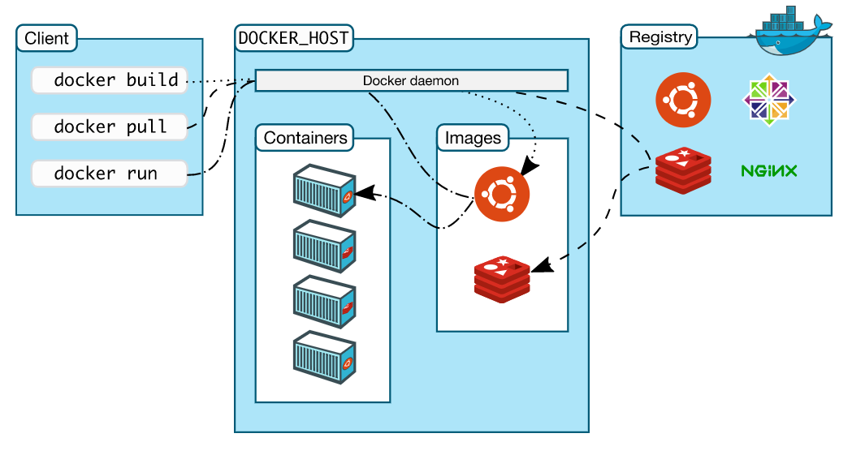
Docker architecture

Slide 10
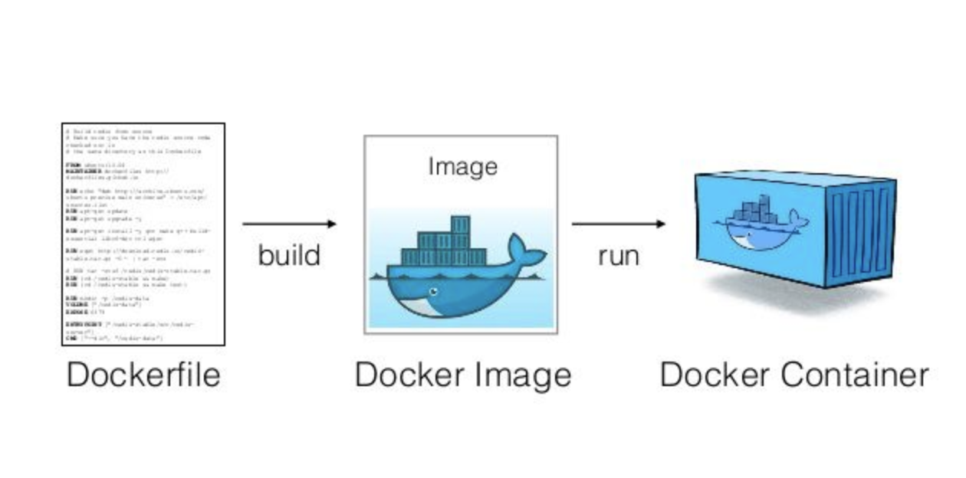

Slide 11
Docker Commands
docker image build -t app .
docker images
docker inspect app
docker pull mongo
docker images
docker exec -it mymongo bash
docker run -d -p 27016:27017 --name mongodb --net bridge mongo
docker network ls
docker ps
docker run -d -p 8081:8081 --name mongodbtut --net bridge --link mongodb:mongo app
docker logs <container-id>/mongodbtut

Slide 12
My learning summary
AWS Basics
Fundamental of AWS
EC2
Type of EC2
Create EC2 Instance
Aws LightSail
Hands on exercise
Book Store Crud operation using Non Blocking Rest API using Annotated Controller with MongoDb POC

Slide 13
What did I enjoy the most?
Working on Non Blocking Rest API POC.
Learning Docker and Creating POC
Launching AWS Instance and depyment of POC project on that.

Slide 14
Here are my learning goals for next quarter
Hands on exercise(s)
Create Reactive Application with NoSql databse that uses the most of AWS services that make it scalable and cost efficient.
Knowledge sharing activity
blog on concept of Spring Reactive.
Dig deeper into
Java 8 Features
Reactive Programming
Automation using AWS

Slide 15
Thank you & looking forward to work together on different projects

